Slide 1
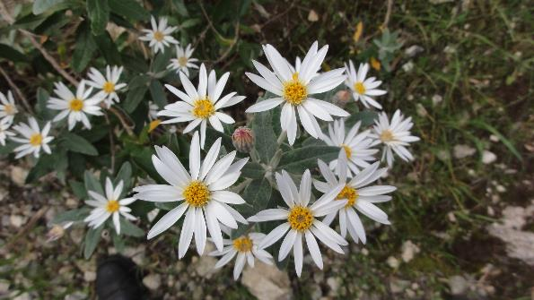
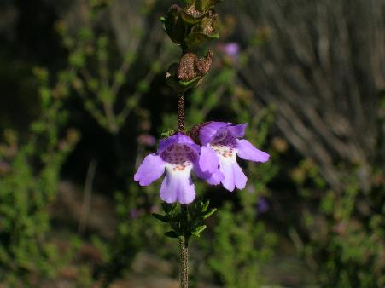
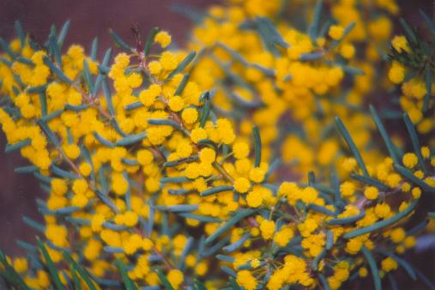
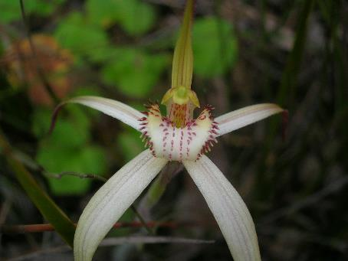
Monitoring and Evaluation
Kylie Moritz
Restoration Ecologist
Natural Resources SA Murray-Darling Basin
Notes:
Take a look at the key things you need to think about when designing a monitoring program for your translocation
Through the talk I’ll weave through a case study on the Wollemi Pine to demonstrate how M&E can be applied

Slide 2
Why monitor?
Find out what’s going on
Evaluate success/failure and find out why
What conditions lead to success
Refine management
Knowledge
Species ecology
Reporting – investment and resource use
Permit may require monitoring
Monitoring direct-seeded translocation of Veronica parnkalliana following a prescribed burn.
(Photo: M Jusaitis)
Notes:
Conditions (ie microclimate, initial size of plants, mgt intervention
Gain Knowledge – is it the first translocation of the species? – how has is performed in natural environment – its impact on the natural environment?
Species Ecology - improving understanding of biology, life history, & habitat requirements

Slide 3
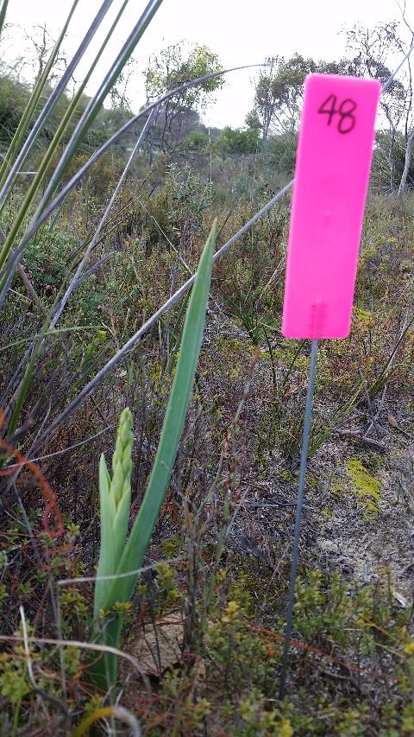
Monitoring types
Surveillance monitoring:
monitor for changes (or problems)
Diagnostic monitoring:
monitor change and determine reasons for changes success or problems
monitoring is designed to include explanatory variables
Notes:
Surveillance monitoring:
particularly relevant where there is potential for unexpected problems
Diagnostic monitoring:
Monitor change and determine reasons for changes,
monitoring is designed to include variables (ie mgt intervention type, microclimate, plant size) that can be used to explain success or failure.

Slide 4
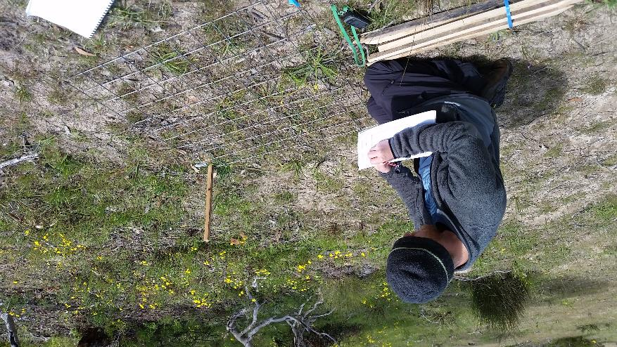
Set monitoring question
From your Goals & Objectives
Example:
Goal Create a self-sustaining population
Objective 90% survival rate of plants at 1 year post-planting
Question What is the survival rate of plants at one year post-
planting?
Notes:
Develop the Monitoring question(s)
closely aligned with the objectives for the translocation
Aim that the Monitoring results should
provide an answer
Evaluate translocation
and direct management

Slide 5
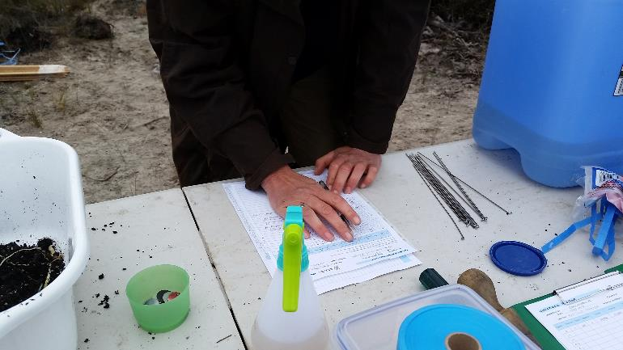
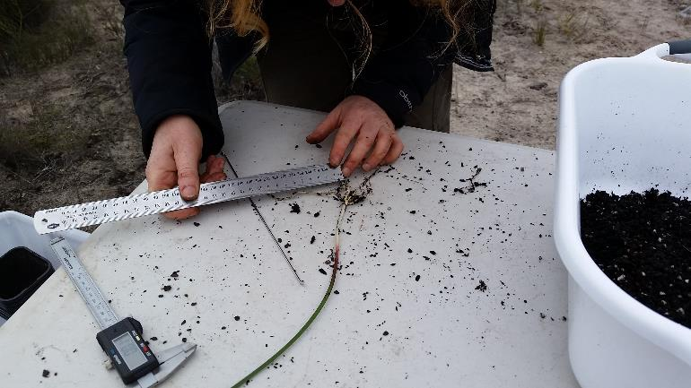
What should be monitored?
Main variables affecting outcome of the translocation
translocated plants
recipient site
management
expenditure
reference population
the ex situ source population
Measuring the tuber of Thelymitra epipactoides before planting
Notes:
Rather than monitoring lots of things poorly, monitor a few things well!
The main variables affecting the outcome of the translocation that need to be monitored are
Will go through each of these, but first have a look at a Case study

Slide 6
Wollemi pine case study: Planting/monitoring design
August 2012
191 plants
30 “light gaps” (creekline to woodland)
6-7 plants in each gap, varying plant size

Slide 7
Wollemi pine case study: Variables
Management (all plants)
Watering at planting & at one month
Caged
Other variables (incorporated into design)
Plant supplier/ Plant size

Slide 8
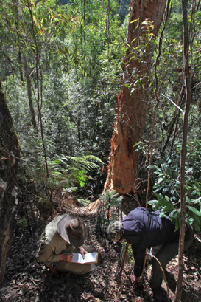
Wollemi pine case study: Monitoring Questions
How does growth (stem length, branch number) and survival of translocated Wollemi pines vary along a light gradient?
How does the effect of light on Wollemi pine growth and survival vary with plant size?

Slide 9
What should be monitored?
translocated plants
recipient site
management
expenditure
reference population
the ex situ source population

Slide 10
Translocated Plants
Commonly monitored plant response variables:
Survival
Growth
Flowering
Seed production
Presence of bulbs/tubers/lignotubers/ramets
Survival of plants to first flowering/maturity
Time to first flowering/maturity
Population size
Presence/abundance of second generation
Survival and growth of second generation to maturity
Monitoring height of Grevillea calliantha (photo: R. Dillion)
*Censusing all plants = no sampling error
Notes:
Ultimately the responses of the translocated plants will determine whether the translocation is successful or not
What should be monitor is determined by
- the objective or question and
- species life history
It can often take years or decades for a translocated population to reach the ultimate goal of becoming self-sustaining,
So monitor population attributes that indicate progress towards this goal.

Slide 11
Wollemi pine case study: Monitoring the plants
All plants censused
Plants permanently marked
Growth (stem length, number of branches)
Survival
Growth – measure from where to where??.
Measuring translocated Wollemi pine with a flexible builders tape.
(Photo: H. Zimmer)
Wollemi pine that has died back and resprouted
Plant tagging system

Slide 12
What should be monitored?
translocated plants
recipient site
management
expenditure
reference population
the ex situ source population

Slide 13
Recipient site
Two main reasons:
Recipient site variables
Explain response of translocated population due to site variables
(ie. diagnostic monitoring)
Impact on recipient site
Identify impacts of the translocated population on the recipient
site (ie. surveillance monitoring)
Data logging station set up at a Brachyscome muelleri translocation site to monitor climatic conditions. (Photo: M. Jusaitis)

Slide 14
1. Recipient site environmental variables
Commonly monitored environmental variables
Soil, soil moisture
Rainfall
Temperature
Light
Community composition
Disturbances
Guided by your monitoring question:
ie. to what extent is growth correlated with soil moisture?
(monitor soil moisture)
PERMANENT marking of quadrats and transects = remove spatial variation with resampling (focus on actual change)
Plan sampling so it is NOT biased: random, stratified random, systematic
Notes:
Spatial scale could be within site (indiv plants, microsite, group of plants) or between sites (natural vs translocated)

Slide 15
2. Impact on recipient site
Looking for unexpected problems such as:
Declines/increases of local species (ie over shading, competition)
Introduction of weeds/pests
Introduction of pathogens eg. Phytophthora, Myrtle Rust
Changes to abiotic factors eg. soil nutrients, soil moisture, sun shade, microclimate, hydrology

Slide 16
Wollemi pine case study: Monitoring the recipient site
Baseline data
Light availability
Soil nutrients
Phytophthora
Temperature
Rainfall
Ongoing monitoring
Temperature
Humidity
Soil microbial community

Slide 17
Wollemi pine case study:
Response (y) variables = Growth and Survival
Explanatory (x) variables = Light and Plant Size
Notes:
Response variables = growth and survival
Explanatory variable = light and plant size

Slide 18
What should be monitored?
translocated plants
recipient site
management
expenditure
reference population
the ex situ source population

Slide 19
Management and other controlled variables
Explaining changes in plant population - according to management (incorporate into design)
Common management actions:
Fencing
Watering
Weeding
Burning
Fertiliser addition
Other controlled variables
Planting technique
Propagule type
Plant supplier
Plant pre-treatment
Use CONTROLS to confidently attribute changes to management
Experimental design – vary factor of interest, hold all others constant –where possible!
Notes:
Plant response can be attributed to management if there is a comparison with an unmanaged site (control site)

Slide 20
What should be monitored?
translocated plants
recipient site
management
expenditure
reference population
the ex situ source population
Notes:
Expenditure
Enables evaluation of cost effectiveness and return on investment
Helps with planning future translocations
Reference population
survival rates, fecundity and recruitment
to provide a comparison to translocated site
Ex situ population
monitor as may be needed to supplement translocation

Slide 21
Timing and duration of monitoring
Timing
Species life history is key
perennial, ephemeral
flowers, fruits, etc
Frequency
Depends on variation
plant survival and growth (months, years)
temperature (daily)
soil (years?)
plant composition (months, years)
Duration
Until objectives are met
For ephemeral species, disturbance responders … Must compare “like with like”.
Rule of thumb: Monitor several times in first year, then annually
Notes:
Timing and frequency of monitoring will be guided by
- Monitoring question
- Species life history
- Environment in which the species occurs

Slide 22
Wollemi pine case study: Timing of monitoring
Timing
Wollemi pine is perennial and easy to identify (can monitor any time of year)
Frequency
Four visits in 6 months post planting
Annual visits in February
Duration
Ongoing (until objectives are met)

Slide 23
Flexibility and continuous evaluation
Monitoring methods should be consistent from year to year
Proforma data sheets
Clear instructions (what to measure)
Staff change
Sometimes additions will be required
New observations (surveillance)
Events ie fire or flood
Additional objectives
Enter data asap to identify problems

Slide 24
Evaluation and action
Evaluation - is straightforward with clear goals/objectives/questions and robust monitoring design
Ask, do the monitoring results
answer the monitoring questions?
trigger any management actions?
have an explanation, or is further investigation required?
lead to recommendations for future translocations?

Slide 25
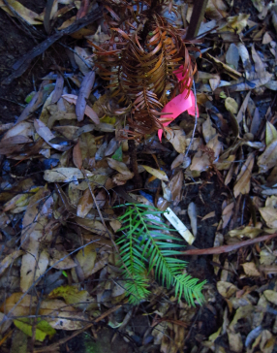
Wollemi pine case study: Flexibility & continuous evaluation
Flexibility
Observations - Grey-black discolouration of branches – Botreyosphareia mortality (unexpected!)
Consistency
Stem length cf. height
Measuring from base to apical meristem
Evaluation
Survival increases with light
Larger plants survived better
Most important factor –supplier/initial
plant condition (not planned!)
Notes:
Flexibility with monitoring enabled picking up presence of pathogen which cause mortality
Consistency enables samplers to know what to measure – from base to apical meristem
Evaluation ….of monitoring results ….

Slide 26
Key messages
Document what you’re trying to achieve (goals, objectives)
Give yourself the best chance to explain the results (explanatory variables – management, environment)
Permanently tag and census all plants
Monitor frequently in year one, and then annually
Compare like with like
Be clear on what you’re measuring, but look out for surprises

Slide 27
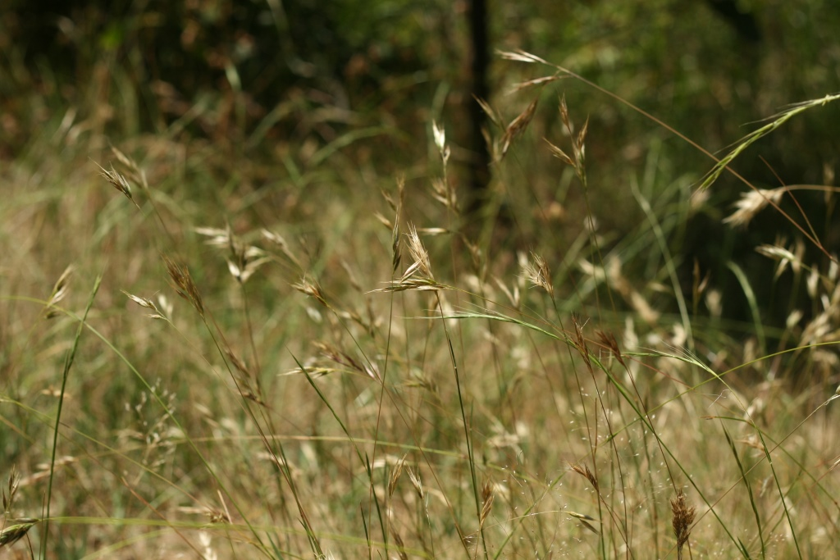
Thank you & Acknowledgements
Heidi Zimmer
Lucy Commander

