Slide 1
Plant Germplasm Conservation
in Australia:
Strategies and guidelines for developing, managing and utilising ex situ collections
First edition, 1997
Second edition, 2009
Third edition, 2021
https://www.anpc.asn.au/plant-germplasm/
Dr Amelia Martyn Yenson
Project Manager
Australian Network for Plant Conservation
Amelia.Yenson@botanicgardens.nsw.gov.au
Notes:
I’m going to give you a quick overview of the Germplasm Guidelines, so you know what information is available. I’d also like to take a look at how ex situ conservation supports in situ conservation.
The new edition of ‘Plant Germplasm Conservation in Australia – strategies and guidelines for developing, managing and utilising ex situ collections’ (known as the Germplasm Guidelines) was launched by Professor Tim Entwisle on 7 September 2021, during the Australasian Seed Science Conference. These guidelines have been revised with grant funding from The Ian Potter Foundation, as a joint initiative of the Australian Network for Plant Conservation and the Australian Seed Bank Partnership.
The Guidelines are written for a range of users, including conservation agencies, scientists, seed bank and botanic gardens staff, students, volunteers and not-for-profit organisations, ecologists, consultants and anyone interested in applied plant biology. They will be useful for professionals new to plant conservation projects, and those adding ex situ actions to conservation advice, recovery plans or policy.
The Guidelines aim to support conservation of Australian plant species and include several case studies on conservation of threatened species in New Zealand. However, the Germplasm Guidelines may also be valuable to those working on different floras, especially those beginning the critical work of conserving diversity in ex situ collections. While some seedbanks and conservation partnerships are well-resourced, the authors of the Guidelines aim to meet the needs of users at a range of resource levels.

Slide 2
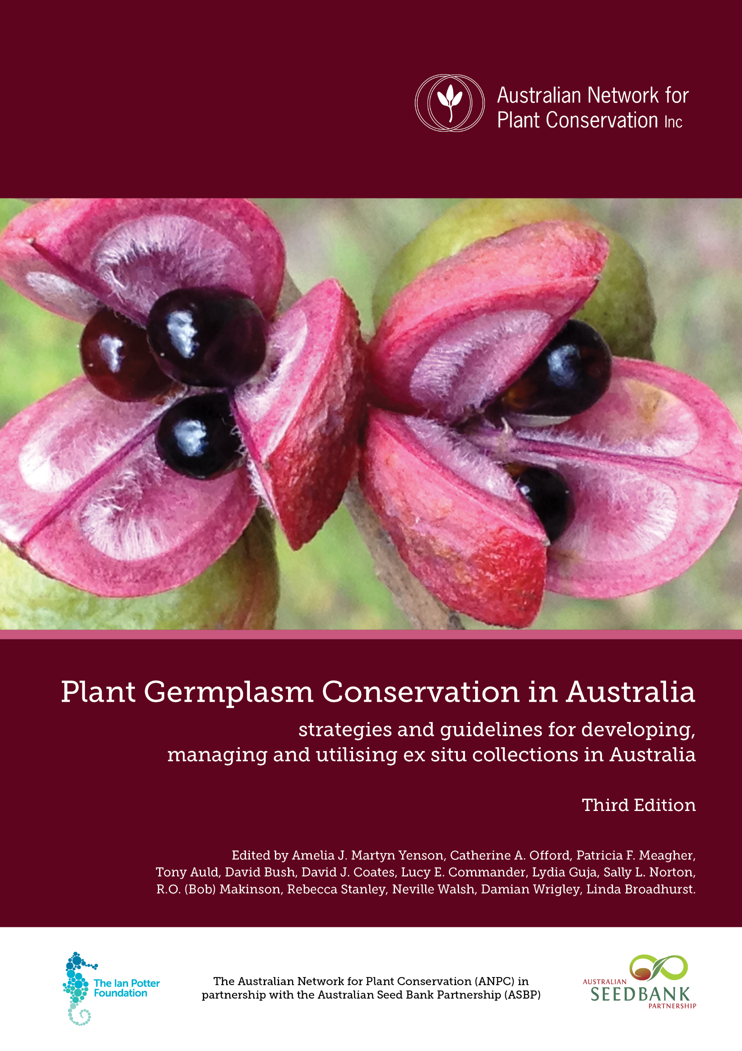
Evidence based
Recently updated
Written by experts
Reviews literature
Plain English
Aimed at improving practices
For time poor & information hungry
Notes:
This is the third edition of the guidelines for ex situ plant conservation, for plant collections held off site or away from their natural habitat. The Germplasm Guidelines are focused on conservation of common and threatened plant species, including many species that are endemic to Australia. The Guidelines provide an evidence-based best practice guide for the management of ex situ (off site) collections of seeds, plant tissues, or plants in nurseries and living collections. The guidelines aim to provide access to current research findings and practice to maximise the value of every seed or plant collection.
The updated Germplasm Guidelines complement the recent revision of the Guidelines for Translocation of Threatened Plants in Australia (2018) and the Florabank Guidelines (2021), a component of the Healthy Seeds Project.

Slide 3
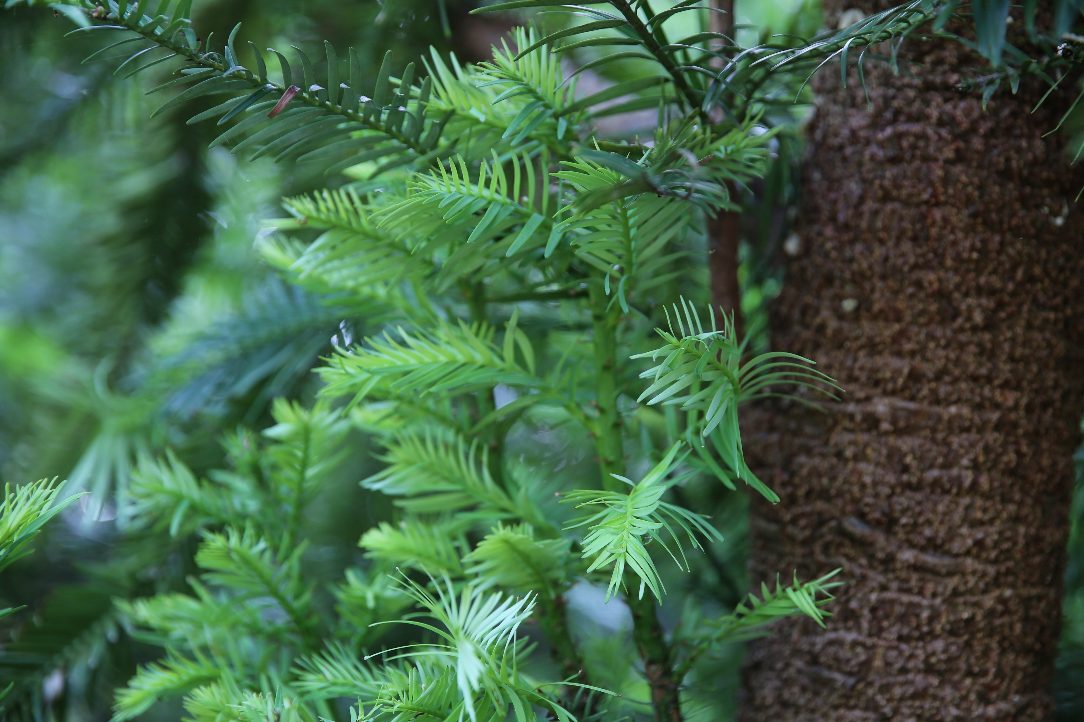
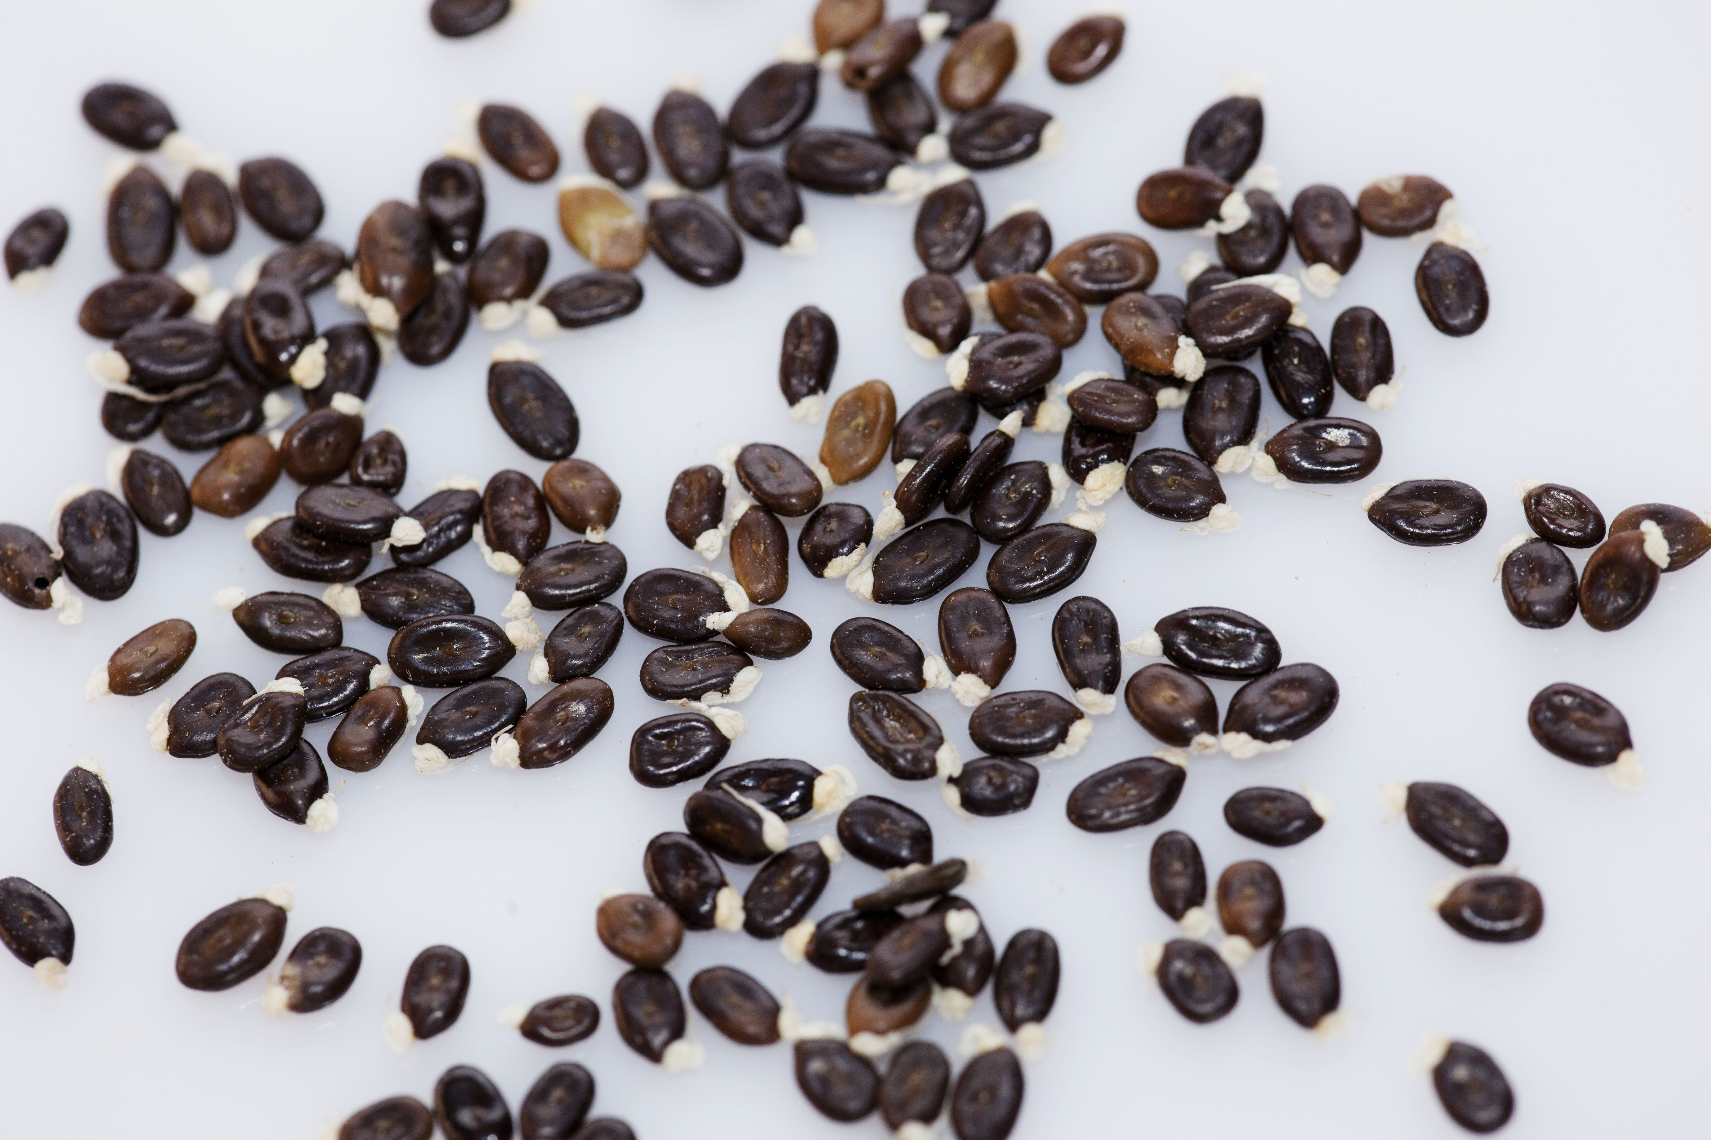
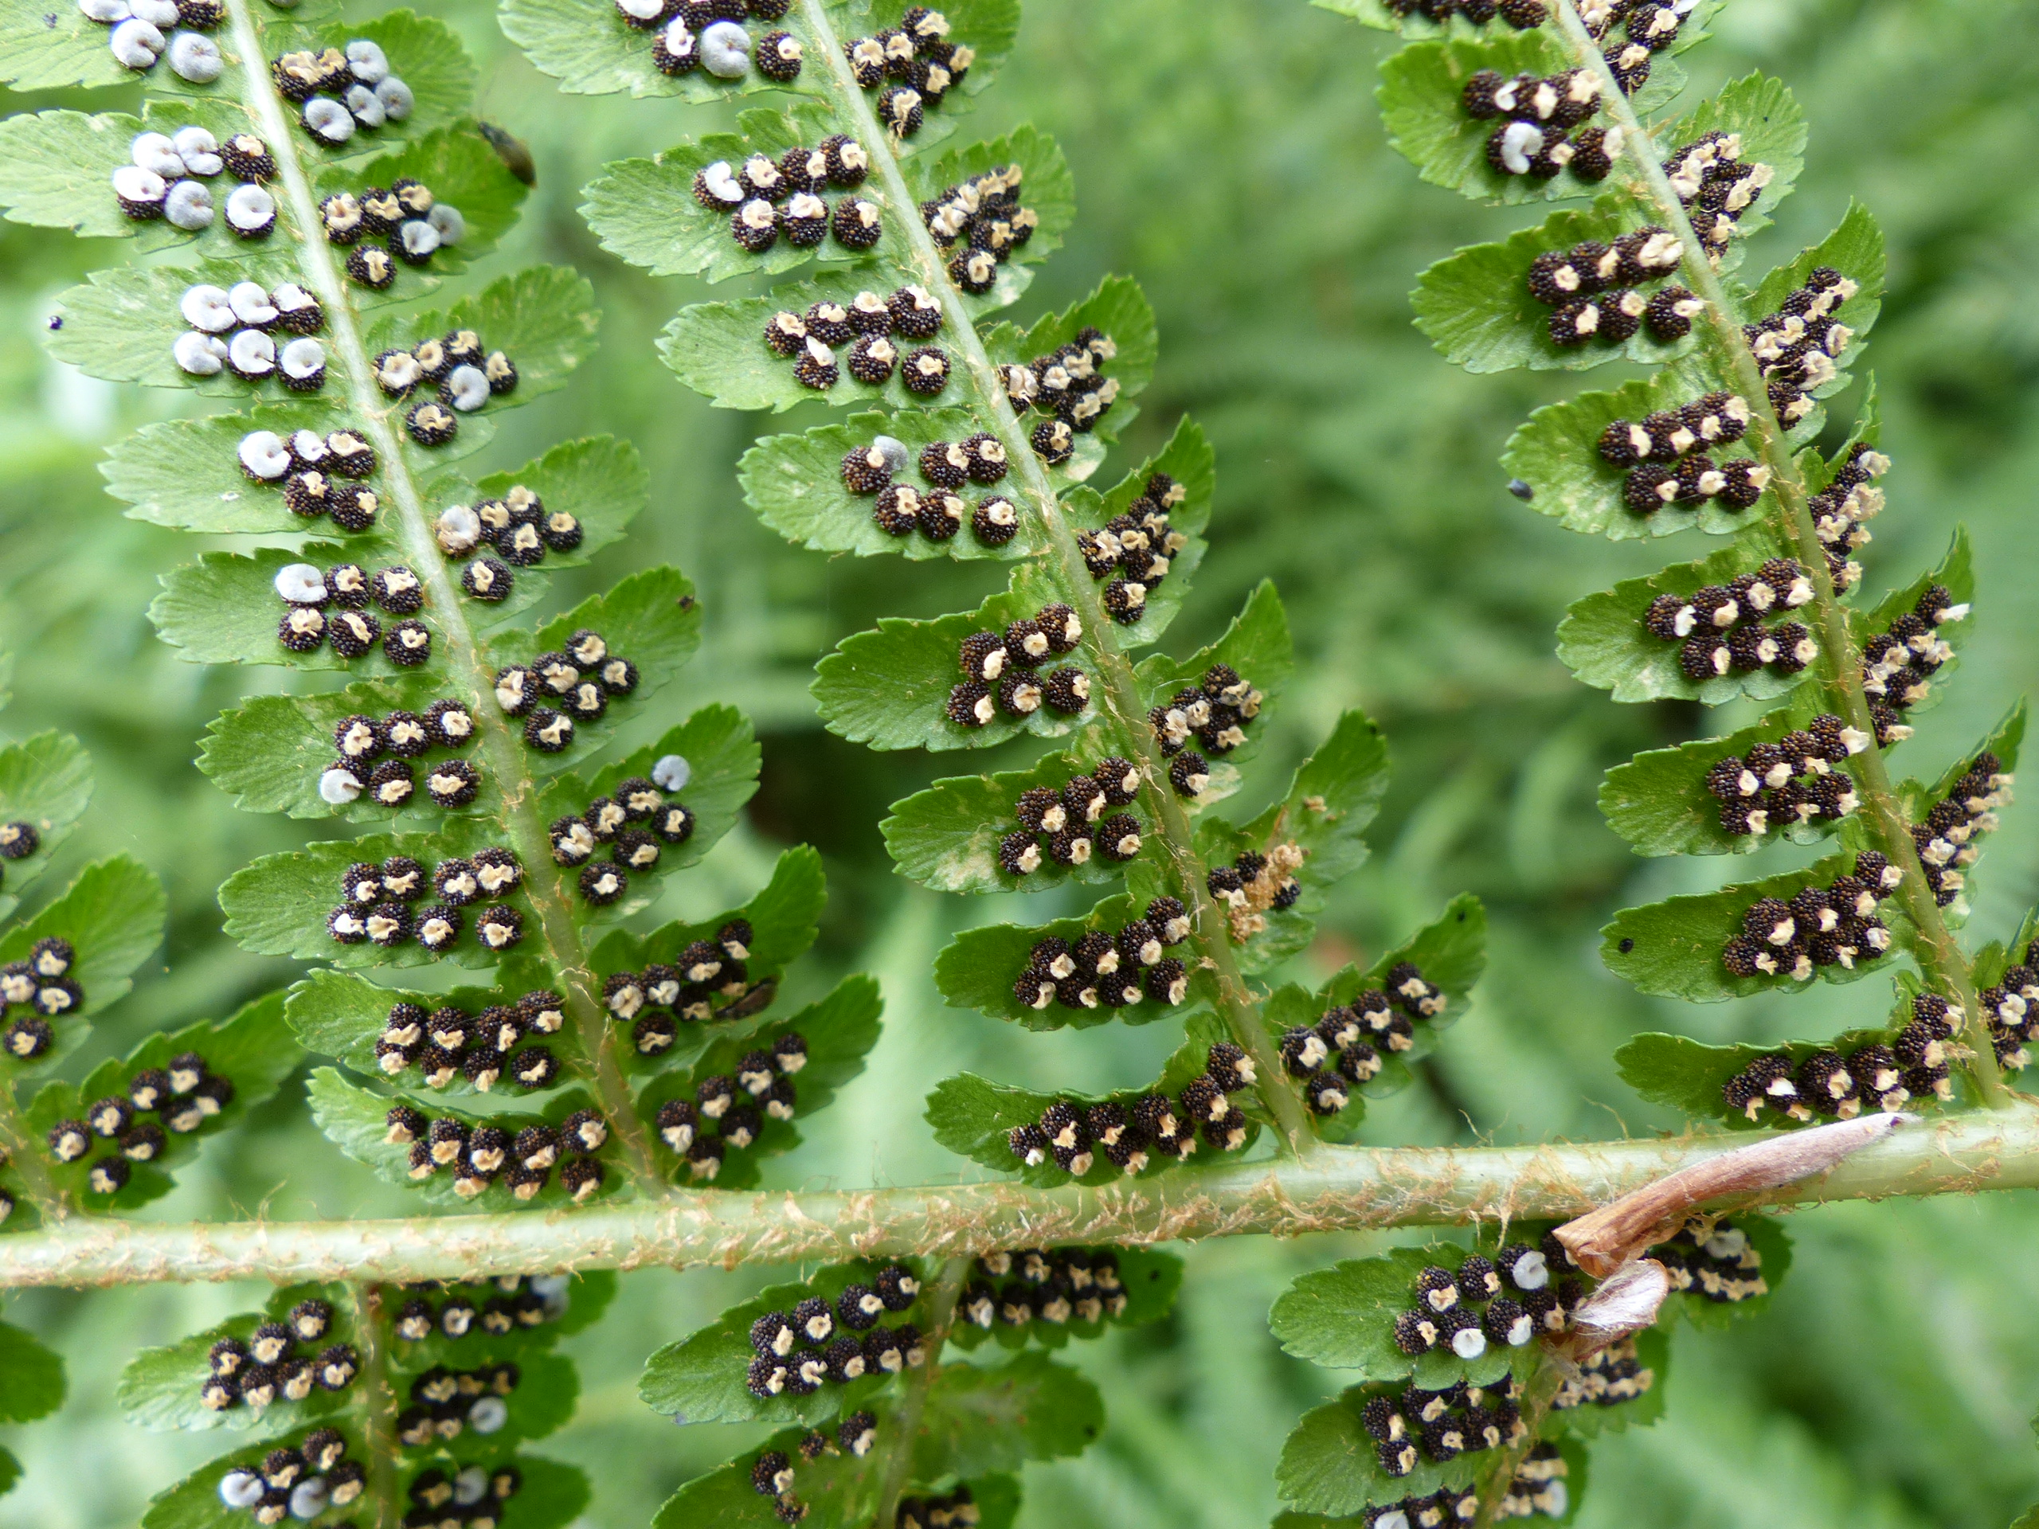
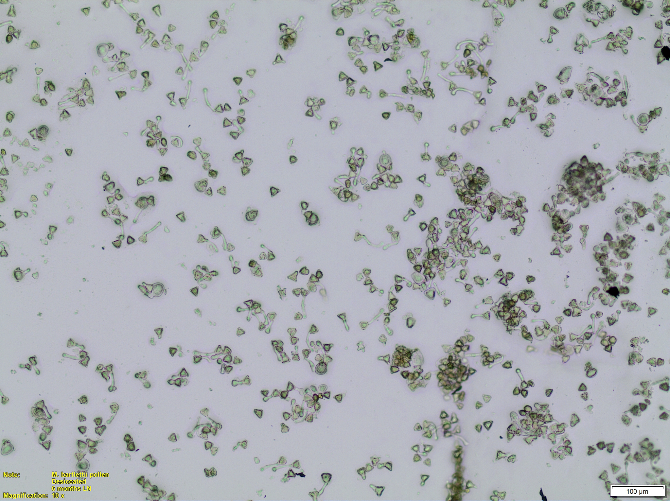
“Germplasm is living tissue from which new plants can be grown.
It can be a seed or another plant part – a leaf, a piece of stem, pollen or even just a few cells that can be turned into a whole plant.
Germplasm contains the information for a species’ genetic makeup, a valuable natural resource of plant diversity.”
UC Davis Seed Biotechnology Center 2020
Branches of Wollemi Pine. Image: A Martyn Yenson.
Acacia seeds. Image: S Cottrell.
Flannel Flowers in tissue culture. Image: RBG&DT.
Spores on a fern frond. Image: D Ballesteros.
Pollen grains of Metrosideros. Image: K van der Walt.
Notes:
Did you know? Germplasm is any living tissue - such as seeds, cuttings or spores - from which new plants can be grown.
In the Guidelines, we have chapters on seed banking, tissue culture, cryopreservation and living collections, which are all germplasm collections that make it possible to capture genetic diversity for the future.
An ex situ conservation strategy should aim to capture genetic variation at the species, population, individual and allelic levels as this diversity provides the basis for adaptation to current and future environmental conditions. Ex situ germplasm conservation enables the use of this captured diversity in a variety of ways, primarily to enhance in situ conservation efforts.

Slide 4
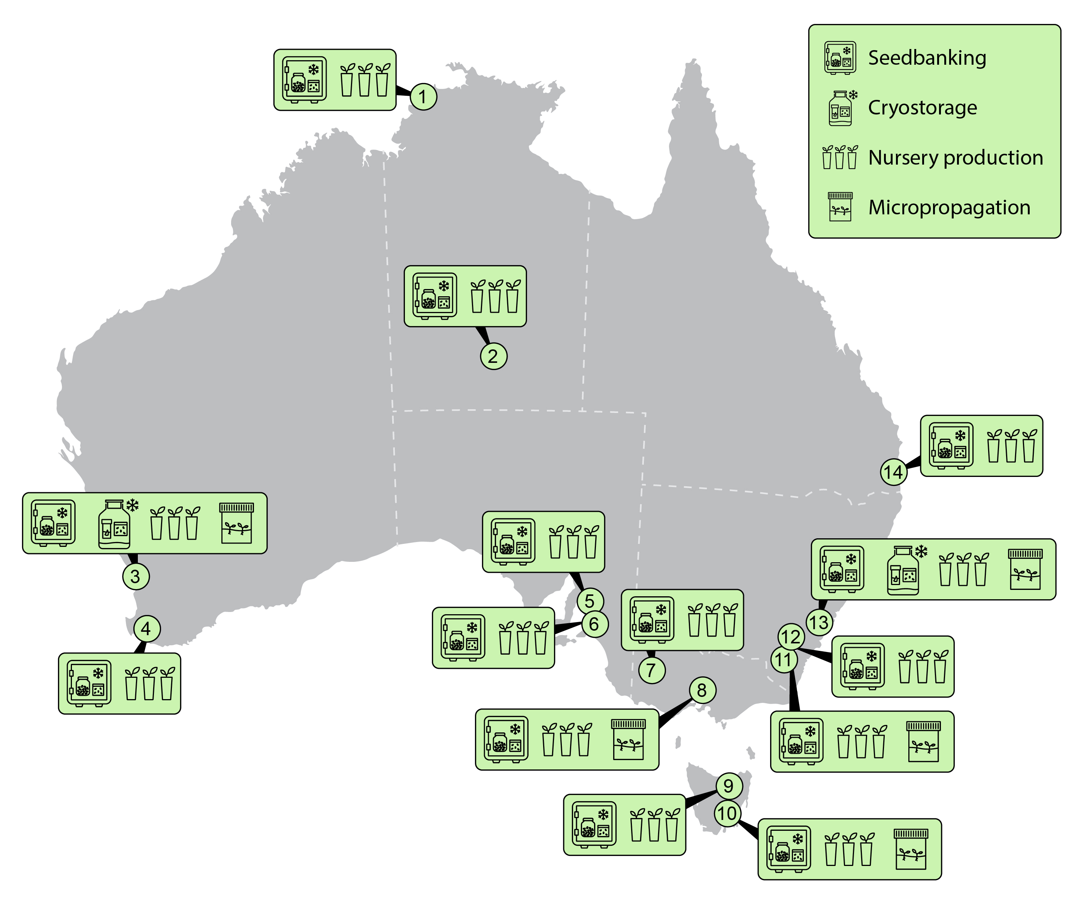
Where are Australia’s germplasm collections located?
Figure 2.4: Location of major ex situ conservation facilities for Australian flora, including ASBP Partners, the Australian Tree Seed Centre, the Australian Grains Genebank and Australian Pastures Genebank (both storing crop wild relatives) and major forestry seed banks with conservation collections.
1. George Brown Darwin Botanic Gardens conservation seed bank
2. Alice Springs Desert Park
3. Western Australian Seed Centre
4. Forest Products Commission Seed Centre
5. Australian Pastures Genebank
6. South Australian Seed Conservation Centre
7. Australian Grains Genebank
8. Victorian Conservation Seedbank, Royal Botanic Gardens Victoria
9. Tasmanian Seed Centre, Sustainable Timber Tasmania
10. Tasmanian Seed Conservation Centre, Royal Tasmanian Botanical Gardens
11. National Seed Bank, Australian National Botanic Gardens
12. Australian Tree Seed Centre, CSIRO
13. Australian PlantBank, Australian Institute of Botanical Science
14. Brisbane Botanic Gardens Conservation Seed Bank, Mt Coot-tha
Figure thanks to Craig Miskell camgraphics.com.au
Notes:
If we go around Australia, and look at the germplasm collections of the Australian Seed Bank Partnership and its associates, you can see that seed banks and conservation nurseries are the most common types of germplasm collection. Seed banks and nurseries can be found at many state-based botanic gardens, as well as within other organisations like The Australian Grains Genebank and Australian Pastures Genebank that store wild relatives of crop species. This map from Chapter 2 doesn’t include the smaller restoration seed banks that store wild-collected seed or the regional botanic gardens that grow Australian native plants. So this is not an exhaustive list but it does give you some idea where you can go for advice or assistance.

Slide 5
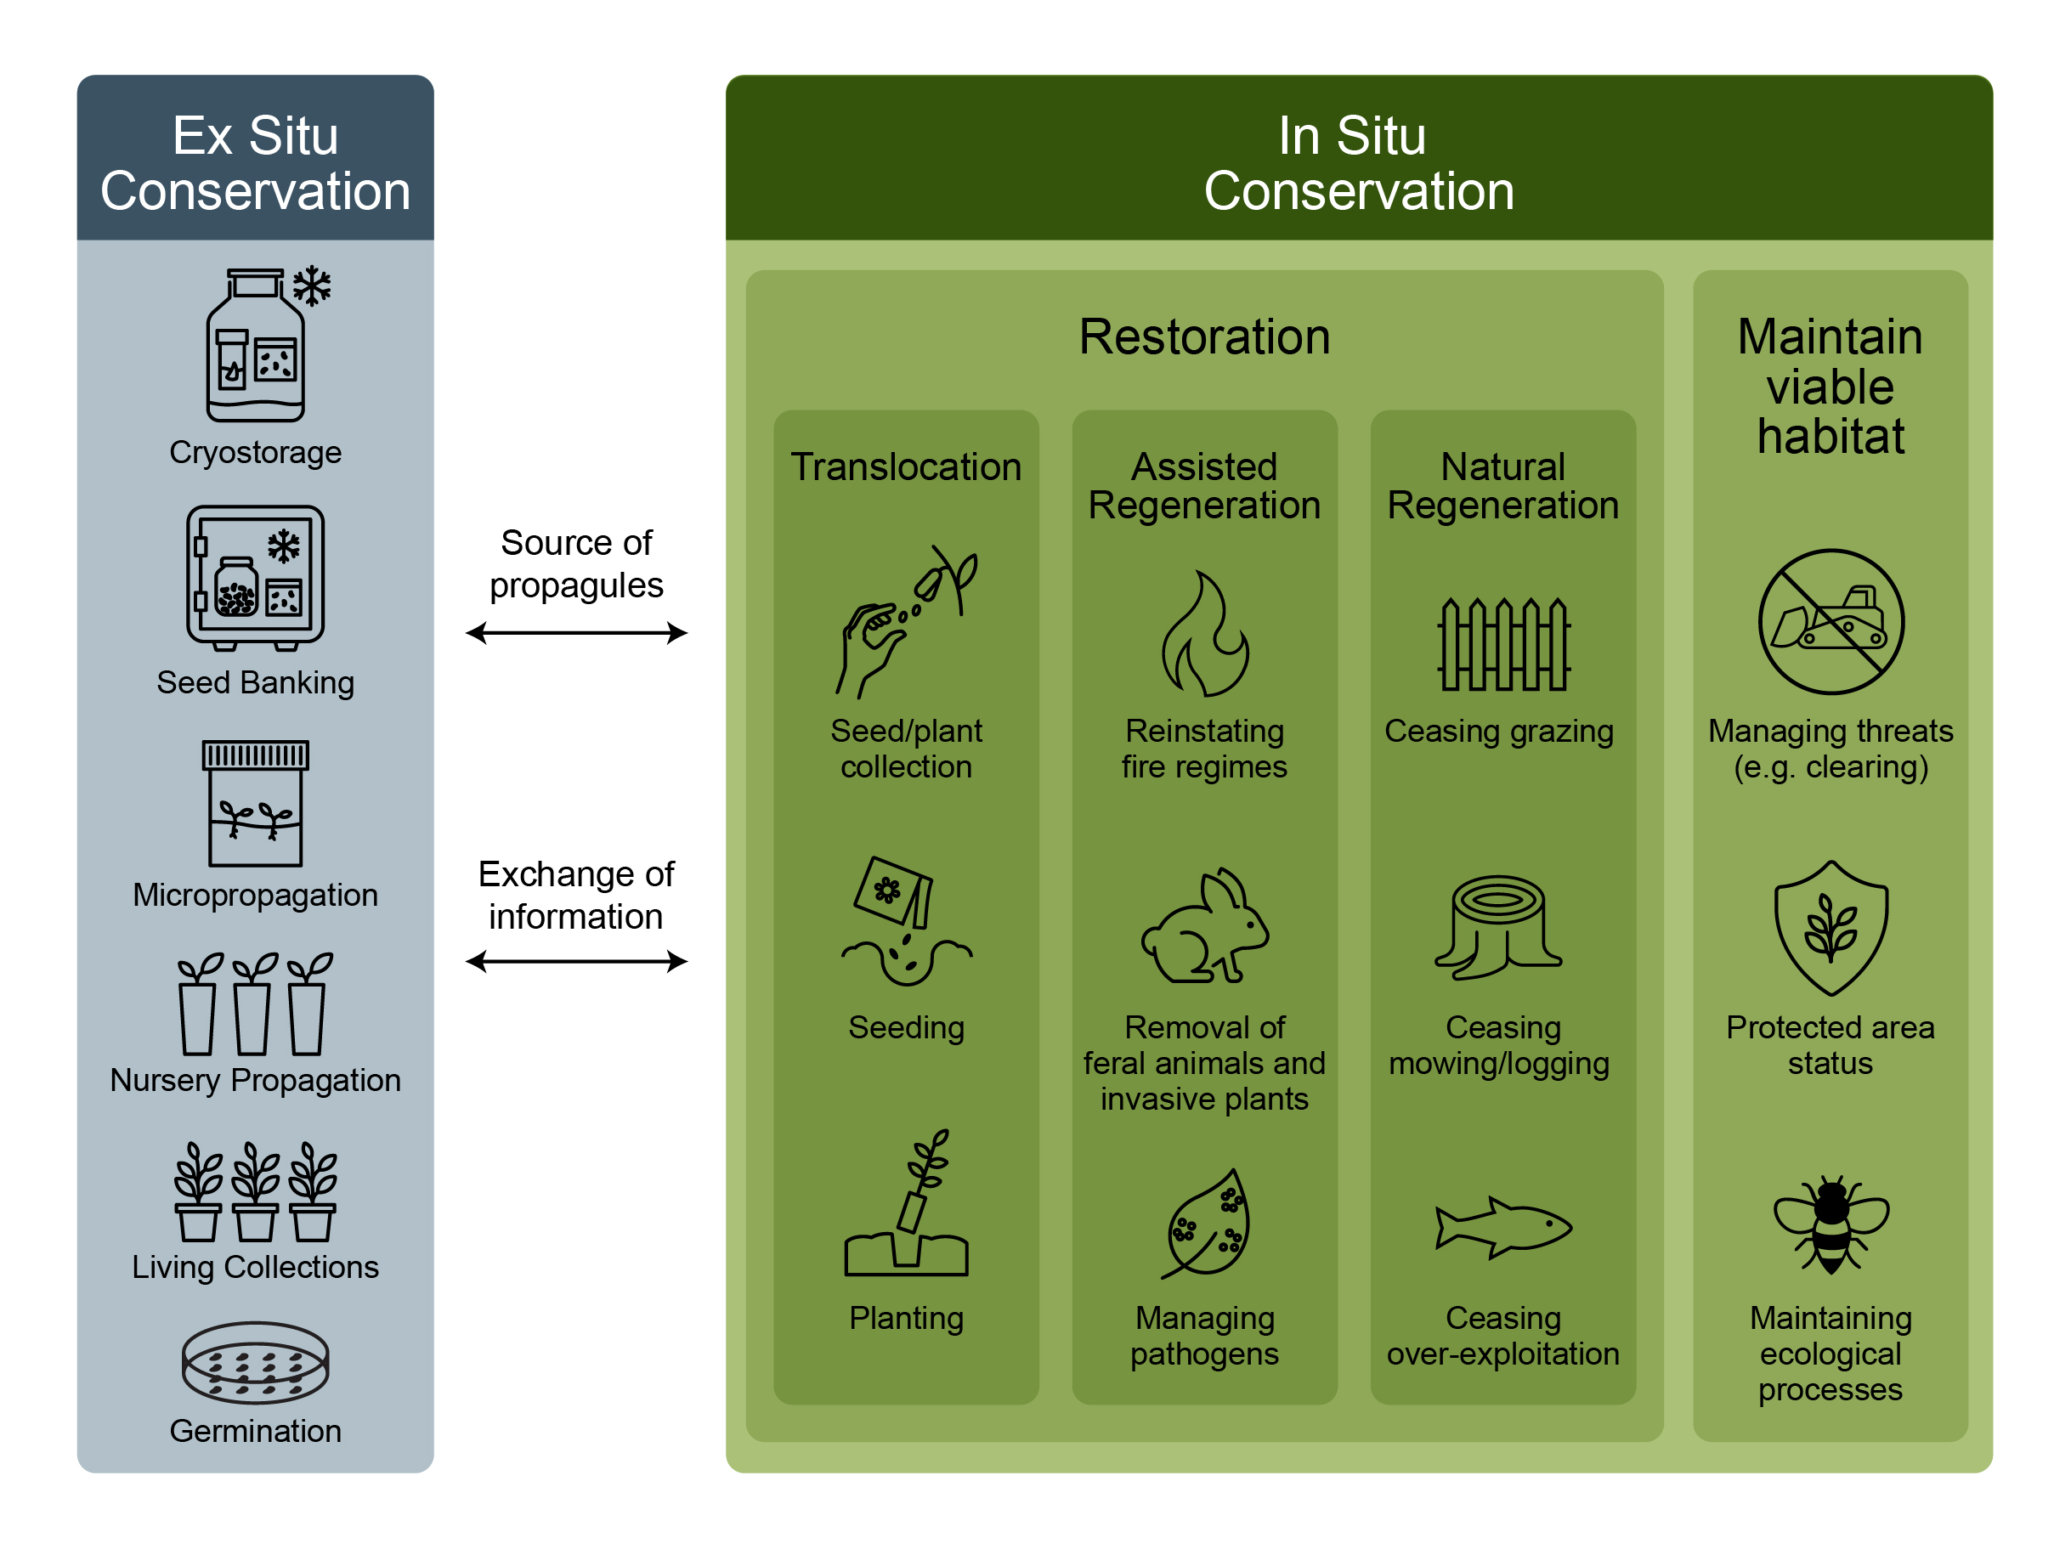
Links between various types of ex situ collections, and their role in supporting in situ ecological restoration approaches
Commander LE, Offord CA, Auld TD (2021) FloraBank Guidelines Module 1 – Introduction. In ‘FloraBank Guidelines (2nd edn).’ (Ed. LE Commander) (FloraBank Consortium: Australia)
Martyn Yenson AJ, Commander LE, Offord CA, Makinson RO (2021) Introduction. In ‘Plant Germplasm Conservation in Australia - strategies and guidelines for developing, managing and utilising ex situ collections in Australia (3rd edn)’ (Ed. AJ Martyn Yenson et al.) (Australian Network for Plant Conservation: Australia)
Figure: Craig Miskell, CAM Graphics.
Notes:
Image caption: Links between various types of ex situ collections, and their role in supporting in situ ecological restoration approaches and actions through provision of propagules and knowledge transfer. Ex situ collections can contribute to the maintenance of viable populations through reintroductions, alongside in situ management activities such as undertaking assisted regeneration and facilitating natural regeneration. The capture of genetic variation, the scale of seed collection and the time frame for curating ex situ collections depends on the project goals. Source: Commander et al. (2021) Florabank Guidelines Module 1.
Description: You can see the range of ex situ collection types in this image in the grey box: cryostorage, seed banking, micropropagation or tissue culture, and living collections. These ex situ, or off site, collections, provide both information and propagules to support in situ (on site) conservation and rely on techniques such as seed germination or nursery propagation. You can see the management actions for in situ populations, or natural habitat, in the green box. Depending on site conditions, the management actions include maintaining habitat in a viable state, promoting natural regeneration, assisting regeneration and more intensive activities such as direct seeding, planting and translocation.

Slide 6
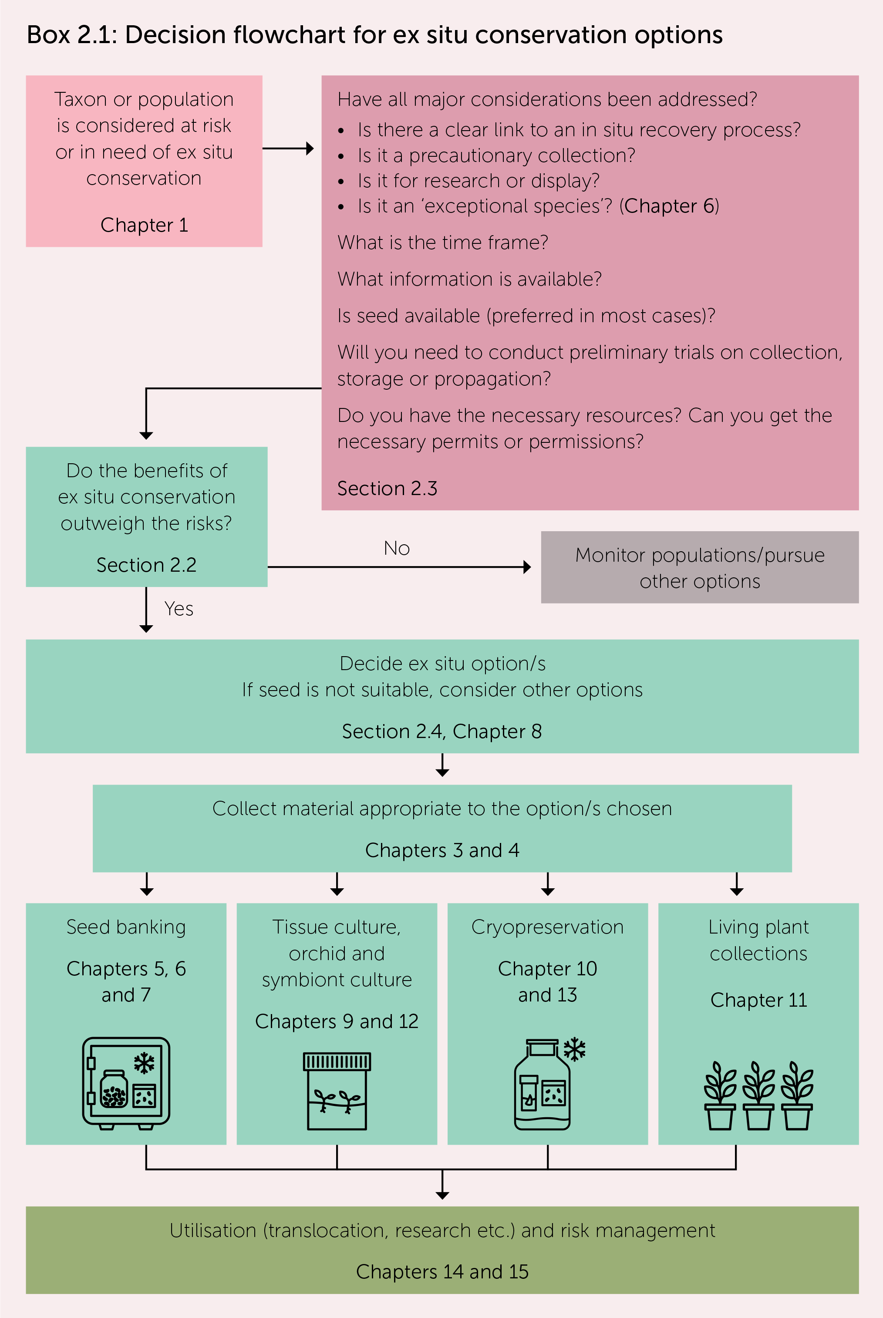
Offord CA, Makinson RO, Guja L, Auld TD (2021) Chapter 2
Options, major considerations and preparation for plant germplasm conservation.
Throughout the Guidelines, boxes indicate key concepts, e.g.,
Box 2.1 Decision flowchart for ex situ conservation
Box 2.2 Deciding where to collect germplasm
Box 2.3 Obtaining permission to collect, hold, utilise germplasm
Notes:
The guidelines begin with a chapter outlining the ex situ options available, what to consider and how to prepare for germplasm conservation. Throughout the Guidelines, there are graphics such as flow charts, pop out boxes and references to source documents, to bring lots of information together in a way that’s easy to use. It’s a great reference for things like licence considerations, how to best capture genetic diversity, seed collecting and propagation tips, and processes for each type of germplasm collection. You can dip into the sections that you need, or use them to find out who else is working on a particular technique or plant family through the chapter author lists and references in each chapter, as well as the comprehensive index.

Slide 7
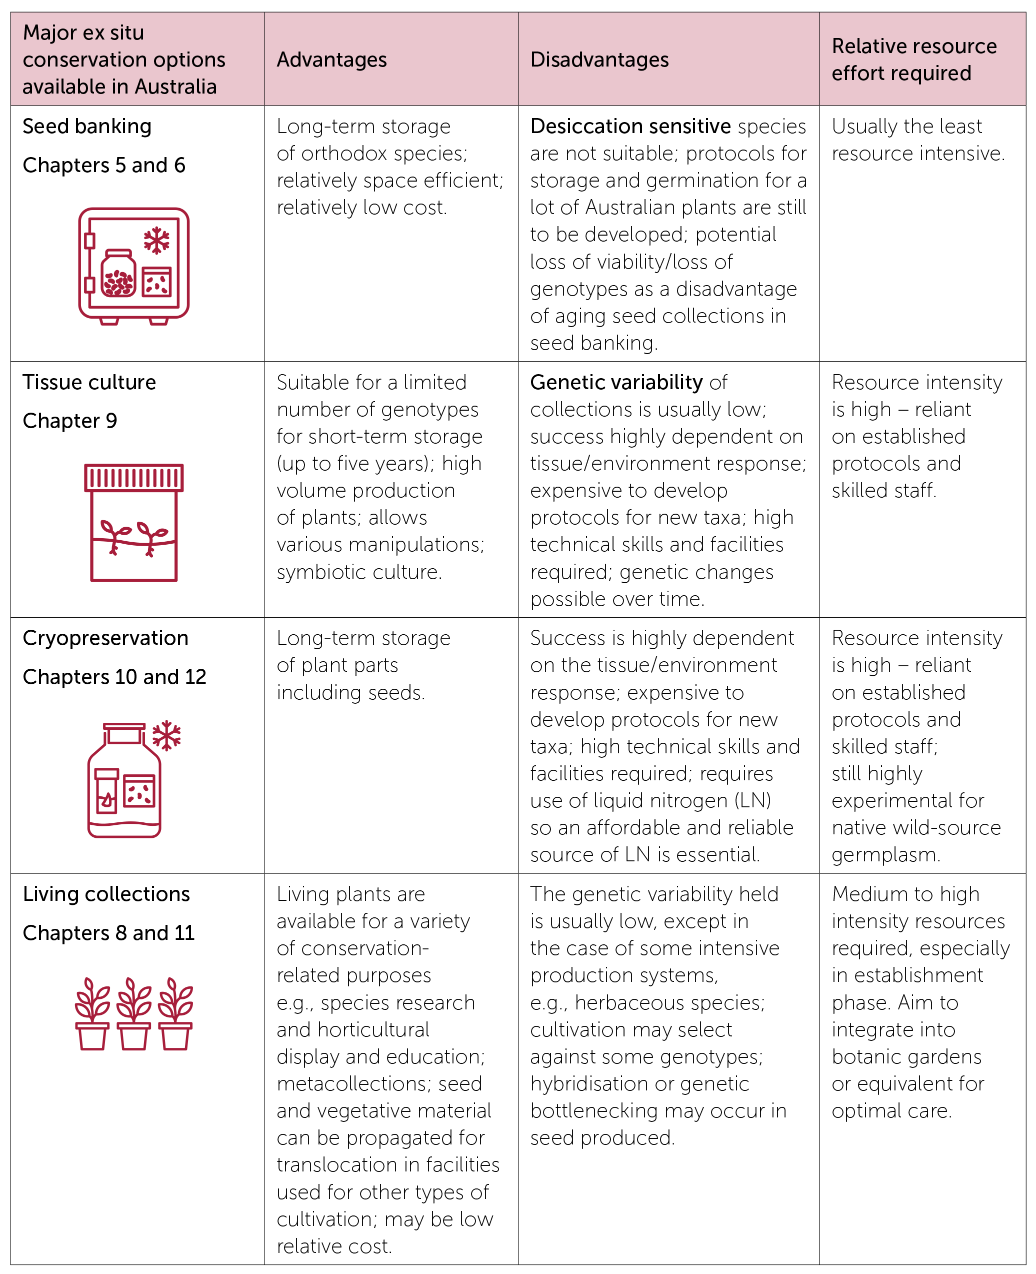
Table 2.1: The major ex situ conservation options available in Australia and their relative advantages and disadvantages.
Icons: CAM Graphics.
Notes:
This table in the Guidelines gives an overview of the advantages and disadvantages of each germplasm collection type. In most cases, seeds are the lowest cost and easiest to maintain, taking up very little space. Although many Australian species have long-lived seeds, we need to remember that seeds don’t last forever, so we need to have a way to use them and to regenerate or recollect that species in future. The other ex situ methods offer particular advantages but require a higher level of technical skill to get into storage, and it can be time consuming and expensive to develop protocols for each species. They also require more maintenance, which can really multiply labour and resource costs in the long term.

Slide 8
Chapter overview
Chapter 1: Introduction. Chapter 2: Options, major considerations and preparation for plant germplasm conservation. *Chapter 3: Genetic guidelines for acquiring and maintaining collections for ex situ conservation. Chapter 4: Seed and vegetative material collection. Chapter 5: Seed banking: orthodox seeds. *Chapter 6: Identifying and conserving non-orthodox seeds. Chapter 7: Seed germination and dormancy. *Chapter 8: The role of the plant nursery in ex situ conservation. Chapter 9: Tissue Culture. Chapter 10: Cryopreservation. Chapter 11: Living Plant Collections. *Chapter 12: Isolation, propagation and storage of orchid mycorrhiza and legume rhizobia. *Chapter 13: Special collections and under-represented taxa in Australasian ex situ conservation programs. *Chapter 14: Risk management and preparing for crises. *Chapter 15: Maintenance, utilisation and information storage.
* Indicates new to this edition
Notes:
The 3rd edition of Plant Germplasm Conservation in Australia shares knowledge about ex situ plant conservation, such as seed storage, which helps safeguard plant diversity for future use in restoration, translocation, horticulture and research.
The Guidelines cover the spectrum of activities from planning and plant material collection through to storage and a diverse range of uses, including species recovery, translocation of nursery-grown plants or seeds, research, establishment of living collections, education, horticultural display and sustainable plant development. This new edition also includes 50 case studies, showcasing ex situ conservation in practice.

Slide 9
Access the Germplasm Guidelines, videos and webinars using QR code or website
https://www.anpc.asn.au/germplasm-guidelines-review/
Notes:
The Germplasm Guidelines are available for free download or ordering of print copies: https://www.anpc.asn.au/plant-germplasm/
A video series and webinar recordings, both based on the guideline’s chapters, support this release and are available on the ANPC YouTube channel (https://www.youtube.com/c/AnpcAsnAu).
You can download the Guidelines and access the videos from our resource page using the QR code on screen now or at https://www.anpc.asn.au/germplasm-guidelines-review/.
Videos:
Plant Treasures: showcasing the ex situ conservation of Australia’s national plant treasures (Figure 4)
Assessing seed storage behaviour: hallmarks of non-orthodox seeds and alternatives to seed banking
The role of the nursery and living collections in ex situ conservation
Using ex situ collections of Australian native species: Translocation and other end uses
Techniques including:
cutting propagation
collection and processing of fern spores
Webinar recordings:
Recordings of ‘Plant Treasures’ webinars co-hosted with the support of Botanic Gardens Australian and New Zealand (BGANZ). Themes include:
data collection and record keeping;
biosecurity in ex situ collections;
the role of the nursery and living collections in conserving native plants species (3 hr special); and
an introduction to seed testing and germination.
Recordings of the Australian Academy of Science Fenner Conference on the Environment: ‘Exceptional times, exceptional plants’

Slide 10
Thanks to all Germplasm Guidelines contributors, lead authors and steering committee members
John Arnott, Tony Auld, Christine Bach, Daniel Ballesteros, Sarah Barrett, Sean Bellairs, Emma Bodley, Jason Bragg, Linda Broadhurst, Eric Bunn, David Bush, Stephanie Chen, Caroline Chong, David Coates, Anne Cochrane, Lucy Commander, Andrew Crawford, Adam Cross, Peter Cuneo, Emma Dalziell, Belinda Davis, Rebecca Dillon, Richard Dimon, Nathan Emery, Graeme Errington, Christine Fernance, Marc Freestone, Bryn Funnekotter, Paul Gibson-Roy, Toby Golson, Joachim Gratzfeld, Alasdair Grigg, Lydia Guja, Lyndle Hardstaff, Megan Hirst, Gemma Hoyle, Ganesha Liyanage, Jo Lynch, Robert (Bob) Makinson, Edward (Joe) McAuliffe, Patricia Meagher, David Merritt, Abby Meyer, Euan Mills, Leonie Monks, Zoe-Joy Newby, Tom North, Sally Norton, Katherine O’Donnell, Cathy Offord, Stig Pederson, Valerie C. Pence, Julie Percival, Lorraine Perrins, Wendy Potts, Noushka Reiter, Amanda Rollason, Maurizio Rossetto, Annisa Satyanti, Jordan Scott, Amanda Shade, John Siemon, Karen Sommerville, Rebecca (Bec) Stanley, Amelia (Millie) Stevens, Nigel Swarts, David Taylor, Vidushi Thusithana, Shane Turner, Marlien van der Merwe, Karin van der Walt, Mark Viler, Veronica Viler, Neville Walsh, Katherine Whitehouse, James Wood, Warren Worboys, Magali Wright, Damian Wrigley, Heidi Zimmer.
Notes:
The Germplasm Guidelines were updated by 78 contributors with oversight from the Germplasm Guidelines steering committee, and the project was funded by The Ian Potter Foundation.
The Australian Network for Plant Conservation acknowledges all the authors who contributed to the Guidelines, and particularly thank the chapter lead authors and steering committee members for their input.
Please download the Guidelines and share them among your colleagues, friends of the gardens, students, and volunteers.

